Slide 1

Automotive Technology: A Systems Approach, 8e
Chapter 29: Fuel Delivery Systems
Rob Thompson and Jack Erjavec, Automotive Technology: A Systems Approach, 8th Edition. © 2025 Cengage. All Rights Reserved. May not be scanned, copied or duplicated, or posted to a publicly accessible website, in whole or in part.

Slide 2
Chapter Objectives (1 of 2)
29.01 Explain the safety precautions for working with gasoline and fuel systems.
29.02 Inspect and service fuel tanks.
29.03 Conduct a visual inspection of a fuel system.
29.04 Explain the function of the fuel filler cap and its function as an emission control device.
29.05 Inspect and service fuel lines and tubing.
29.06 Relieve fuel system pressure.

Slide 3
Chapter Objectives (2 of 2)
29.07 Describe the different fuel filter designs and mountings.
29.08 Remove and replace fuel filters.
29.09 Explain how common electric fuel pump circuits work.
29.10 Conduct a pressure and volume output test on an electric fuel pump.
29.11 Service and test electric fuel pumps.

Slide 4
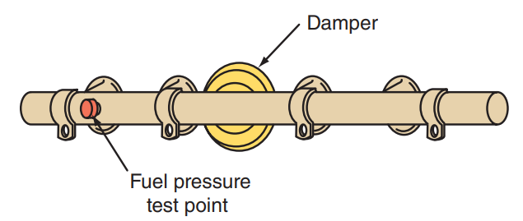
Guidelines for Safely Working on Fuel Systems (1 of 2)
29.01 Explain the safety precautions for working with gasoline and fuel systems.
Fuel in vapor and liquid form presents many potential hazards.
When a fuel line that has pressurized fuel in it is loosened, the fuel will spray uncontrollably as soon as it can.
The fuel can spray on something hot and cause a fire or spray into your eyes and cause a serious injury.
Most port fuel injection fuel rails have a fuel pressure test port (often referred to as the Schrader valve) on the fuel rail.
The pressure can be relieved at this port.

Slide 5
Guidelines for Safely Working on Fuel Systems (2 of 2)
Here are a few safety guidelines to follow:
  Pay strict attention to any and all warning labels located near the fuel system.
  Always wear eye protection and nitrile gloves when working with fuels.
  Follow all other safety rules to prevent injury to yourself or others when servicing fuel systems.
  When working on a fuel system in the engine compartment, disconnect the negative cable of the battery. An electrical spark may cause a fire or explosion.
  Slowly remove the fuel filler cap. If the cap is venting vapor or if you hear a hissing sound, wait until it stops before completely removing the cap.
  Do not smoke when working on or near any fuel-related component.
  Do not allow heat or flames to be near while working on or near the fuel system.
  Handle and store all fuels with the utmost caution.

Slide 6
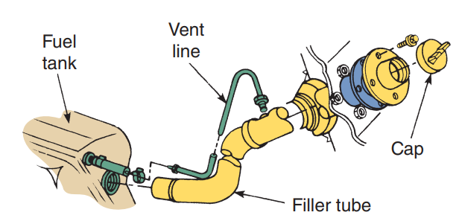
Fuel Tanks (1 of 3)
29.02 Inspect and service fuel tanks.
Fuel tanks include devices that prevent vapors from leaving the tank.
All fuel tank designs provide some control of fuel height when the tank is filled.
Frequently, this control is achieved by using vent lines with the filler tube or tank.
These fuel height controls allow only 90 percent of the tank to be filled.
The remaining 10 percent is for expansion during hot weather.
Some fuel tanks have an overfill limiting valve to prevent overfilling of the tank.

Slide 7
Fuel Tanks (2 of 3)
29.03 Conduct a visual inspection of a fuel system.
Inspection
  Fuel tanks should be inspected for leaks; road damage; corrosion and rust on metal tanks; loose, damaged, or defective seams; loose mounting bolts; and damaged mounting straps.
  Leaks in the fuel tank, lines, or filter may cause a gasoline odor in and around the vehicle, especially during low-speed driving and idling.
  A weak seam, rust, or road damage can cause leaks in the metal fuel tank.
  The best method of permanently solving this problem is to replace the tank.
  Another method is to remove the tank and steam clean or boil it in a caustic solution to remove the gasoline residue.
  After this has been done, the leak can be soldered or brazed by an appropriately equipped specialty shop.
  Be sure to follow manufacturer’s instructions when doing the repair.

Slide 8
Fuel Tanks (3 of 3)
Fuel Tank Service
  To reinstall a repaired or new fuel tank, reverse the removal procedure.
  Be sure that all the rubber or felt tank insulators are in place.
  Then, with the tank straps in place, position the tank. Loosely fit the tank straps around the tank, but do not tighten them.
  Make sure that the hoses, wires, and vent tubes are connected properly. Check the filler neck for alignment and for insertion into the tank.
  Tighten the strap bolts and secure the tank to the car.
  Install all of the tank accessories (vent line, sending unit wires, ground wire, and filler tube).
  Fill the tank with fuel and check it for leaks, especially around the filler neck and the pickup assembly.
  Reconnect the battery and check the fuel gauge for proper operation.

Slide 9
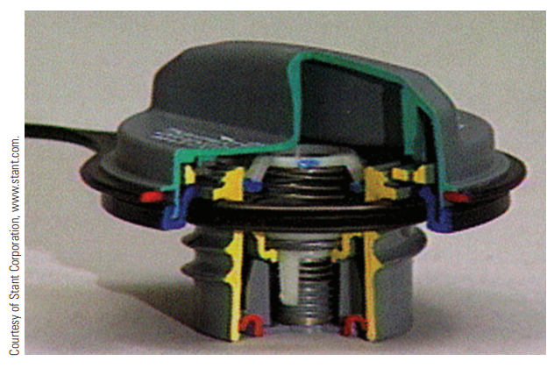
Filler Caps
29.04 Explain the function of the fuel filler cap and its function as an emission control device.
Filler tube caps (commonly called gas or fuel caps) seal the fuel tank while allowing refilling of the tank.
Filler caps are nonventing and have some type of pressure-vacuum relief valve arrangement.
Under normal conditions, the valve is closed.
When extreme pressure or vacuum is present, the relief valve opens to prevent the tank from ballooning or collapsing.
Once the pressure or vacuum is relieved, the valve closes.

Slide 10
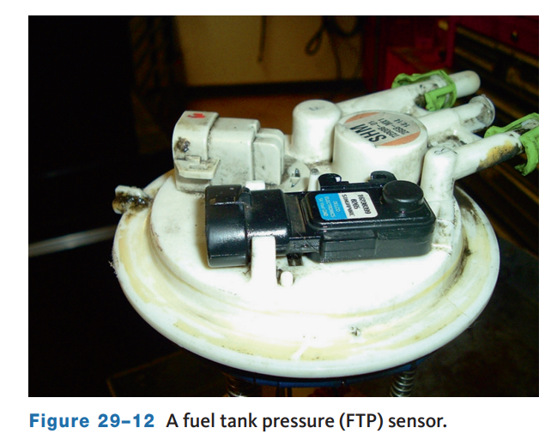
OBD II Monitor
If the gas cap or missing, the ECM/PCM will detect an evaporative system leak and will illuminate a warning message.
On some vehicles, the “Check fuel cap” message will appear each time the engine is started until the system turns the message off.
The message may turn off after the cap is replaced or tightened until at least one click is heard.
If the message does not turn off, there be a leak in the system or the circuit for the message is faulty.
A fuel tank pressure (FTP) sensor is a transducer that converts the absolute pressure in the fuel tank into an input for the PCM.

Slide 11
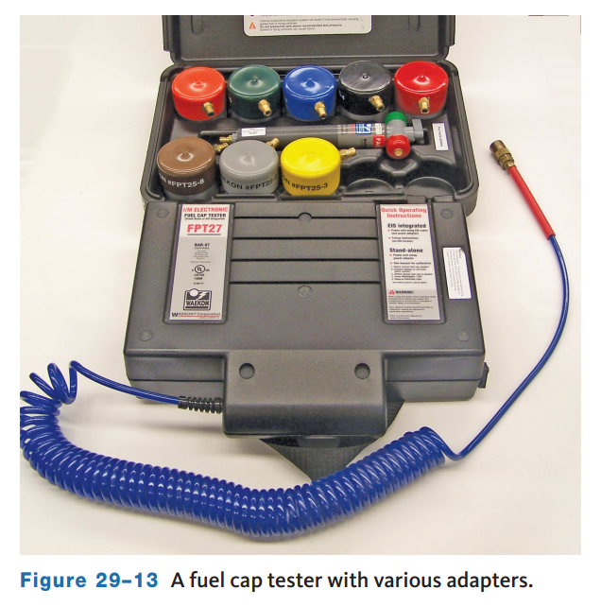
Fuel Cap Testing
A gas cap should be checked whenever the PCM detects a leak in the evaporative system and the cap is securely fastened.
Also, some states, such as California, mandate a gas cap check as part of the annual emissions tests.
A gas cap is checked with a special tester.
The cap is connected to the tester by an adapter specifically designed for the cap.
The tester then applies pressure to the cap and monitors its ability to hold the pressure.
The readout on the tester simply says PASS or FAIL.

Slide 12
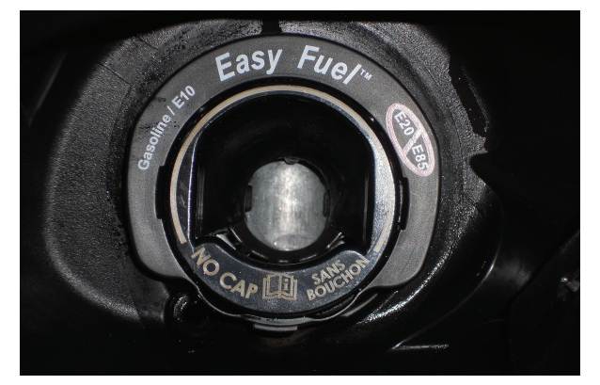
Capless Fuel System
This technology is used on many 2008 and newer Fords as well as other vehicles.
A spring-loaded flapper valve is positioned at the opening for the filler neck.
This valve tightly seals the tank until a fuel nozzle is inserted into the opening.
The nozzle opens the valve and allows for the refilling of fuel.
As soon as the nozzle is removed, the valve is shut by the springs.
A capless fuel system reduces the time the fuel vapors can escape during refueling.
It also makes it more convenient for the consumer, because there is no cap to tighten.

Slide 13
Knowledge Check (1 of 2)
A gas cap left off or loose on an modern vehicle is likely to cause what symptom?

Slide 14
Knowledge Check Answer (1 of 2)
  Answer: If the gas cap or missing, the ECM/PCM will detect an evaporative system leak and will illuminate a warning message.
  On some vehicles, the “Check fuel cap” message will appear each time the engine is started until the system turns the message off.

Slide 15
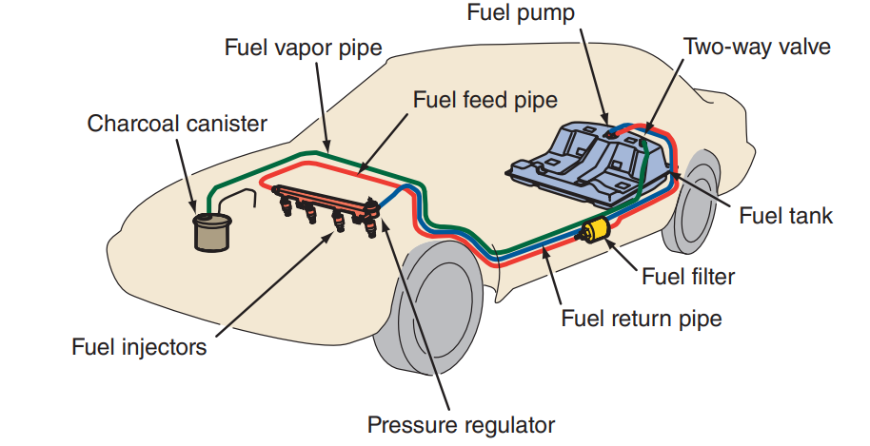
Fuel Lines and Fittings
29.05 Inspect and service fuel lines and tubing.
The fuel lines carry fuel from the tank to the fuel filter and fuel injection assembly.
Fuel lines can be made of either metal tubing or flexible nylon or synthetic rubber hose.
The hoses must also be nonpermeable, so gas and gas vapors cannot evaporate through the hose.
Only hoses made for fuel systems should be used.
Fuel supply lines from the tank to the injectors are routed to follow the frame along the under chassis of the vehicle.

Slide 16
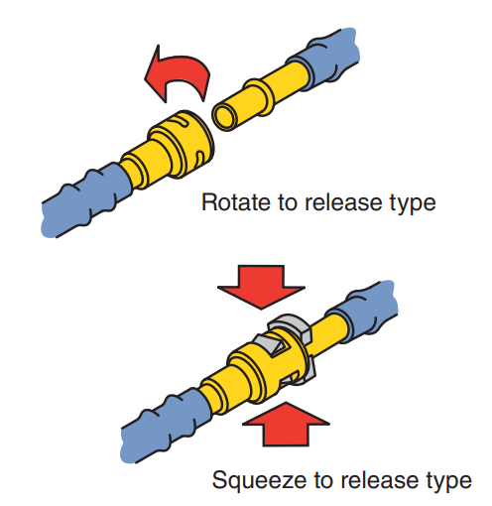
Fittings
Sections of fuel line are assembled together by fittings.
Some of these fittings are a threaded-type fitting, while most are a quick-release design.
Many fuel lines have quick-disconnect fittings with a unique female socket and a compatible male connector.
These quick-disconnect fittings are sealed by an O-ring inside the female connector.
Some of these quick-disconnect fittings have hand-releasable locking tabs, while others require a special tool to release the fitting.

Slide 17
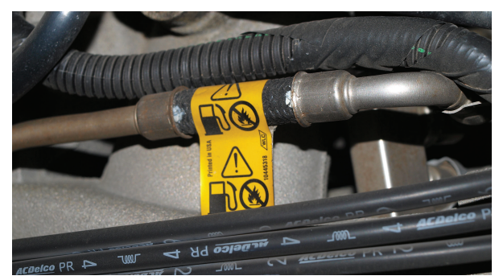
Inspection
All fuel lines should occasionally be inspected for holes, cracks, leaks, kinks, or dents.
Rubber fuel hoses should be inspected for leaks, cracks, cuts, kinks, oil soaking, and soft spots or deterioration.
If any of these conditions is found, the fuel hose should be replaced.
When a rubber fuel hose is installed, the hose should be installed to the proper depth on the metal fitting or line.
Steel tubing should be inspected for leaks, kinks, and deformation.
Tubing should also be checked for loose connections and proper clamping to the chassis.

Slide 18
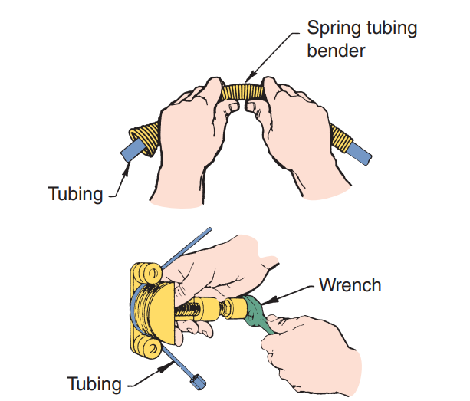
Line Replacement
Any damaged or leaking fuel line must be replaced.
To fabricate a new fuel line, select the correct tube and fitting dimension and start with a length that is slightly longer than the old line.
With the old line as a reference, use a tubing bender to form the same bends in the new line as those that exist in the old.
Although steel tubing can be bent by hand to obtain a gentle curve, any attempt to bend a tight curve by hand usually kinks the tubing.
To avoid kinking, always use a bending tool.

Slide 19
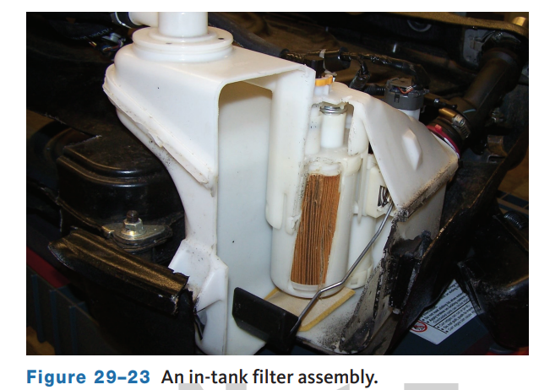
Fuel Filters (1 of 2)
29.07 Describe the different fuel filter designs and mountings.
Automobiles and light trucks have an in-tank strainer and a gasoline filter.
A fuel filter may be in the tank or in the fuel line between the fuel tank and the engine.
Most modern vehicles have eliminated the inline filter and use only the filter in the tank.
This is in part due to the use of plastic fuel tanks and the goal of reducing maintenance costs.
Many of these inline filters are mounted under the vehicle, and others are mounted in the engine compartment.

Slide 20
Fuel Filters (2 of 2)
29.08 Remove and replace fuel filters.
Servicing Filters
  To install a new filter, begin by wiping the male tube ends of the new filter.
  Apply a few drops of clean engine oil to the male tube ends on the filter.
  Check the quick connectors to be sure the large collar on each connector has rotated back to the original position.
  The springs must be visible on the inside diameter of each quick connector.
  Then install the filter and leave the mounting bolt slightly loose.
  Install the outlet connector onto the filter outlet tube and press the connector firmly in place until the spring snaps into position.
  Grasp the fuel line and try to pull this line from the filter to be sure the quick connector is locked in place.
  Then do the same with the inlet connector.
  Now tighten the filter-retaining bolt to the specified torque.

Slide 21
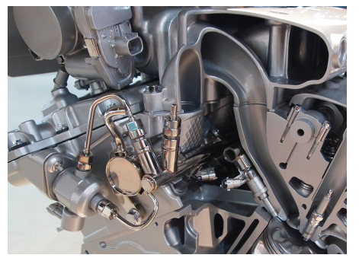
Fuel Pumps
29.09 Explain how common electric fuel pump circuits work.
A fuel pump draws fuel from the fuel tank and pushes it through fuel lines to the engine’s injection system.
All current vehicles use an electric fuel pump.
For vehicles with gasoline direct injection, two fuel pumps are used.
An in-tank electric supply pump delivers fuel to the engine.
Mounted to the engine is a mechanical pump used to raise fuel pressure to between 1,500 and 2,500 psi depending on the system.
When the ignition is turned on, the pump starts to run and shuts off automatically when the fuel line is pressurized.

Slide 22
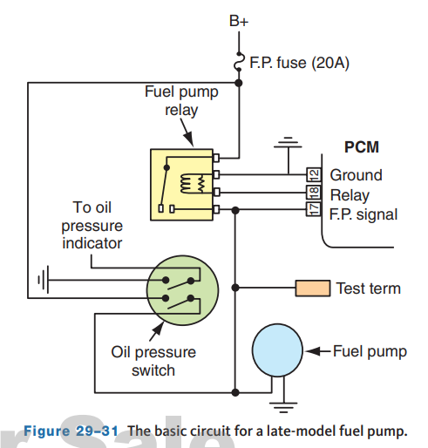
Fuel Pump Circuits
Electric fuel pump circuits vary depending on the vehicle’s make and year.
All fuel pumps on late-model vehicles are controlled by the PCM or through a designated electronic control unit tied into the PCM.
In most returnless systems, the output of the pump is controlled by the PCM through pulse-width modulation.
In these systems, the pump’s output during closed loop is monitored by a fuel rail pressure sensor.
Many direct injection systems use a fuel pump driver module to control pump operation.

Slide 23
Discussion
Fuel pumps controlled by the PCM by pulse-width modulation can speed up and slow down based on fuel demand while the PCM references a fuel rail pressure sensor.
Have a class discussion about this system operation. Describe the fuel pump changes, the changes in fuel pressure, what the conditions are, and similar.

Slide 24
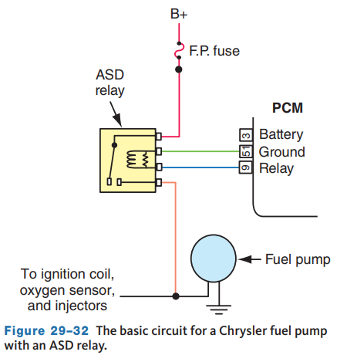
Return Type
In a GM fuel pump circuit (other manufacturers use similar systems), the PCM supplies voltage to the winding of the fuel pump relay when the ignition switch is turned on.
This action closes the relay contacts and voltage is supplied through the relay to the fuel pump.
The fuel pump remains on while the engine is cranking or running.
If the ignition switch is on for 2 seconds and the engine is not cranked, the PCM turns off the voltage to the fuel pump relay to stop the pump.
The fuel pump relay in Chrysler EFI systems is referred to as an automatic shutdown (ASD) relay.

Slide 25
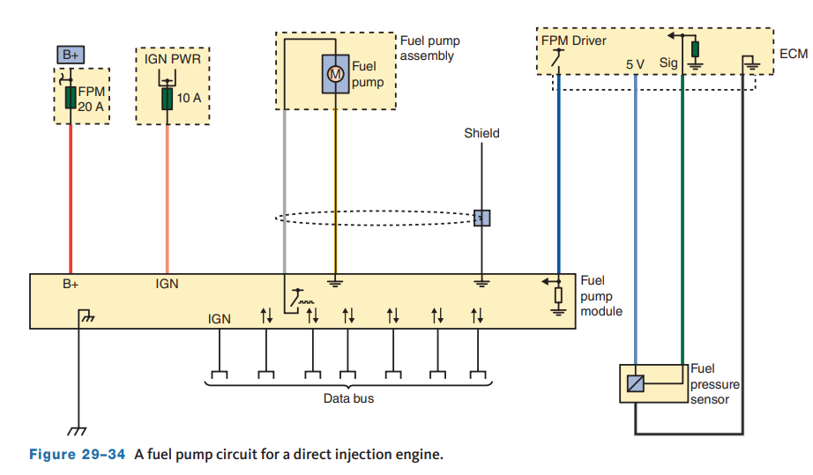
Returnless Systems
In a mechanical returnless system, fuel pressure is maintained by a fuel pressure regulator located in the fuel tank.
Electronic returnless systems control fuel pressure by using pulse-width modulation (PWM) of the fuel pump’s power circuit.
These systems may use the PCM to directly control the pump or a separate fuel pump driver module may be used.
In either system, the fuel pump speed is controlled by rapidly turning the fuel pump circuit on and off.

Slide 26
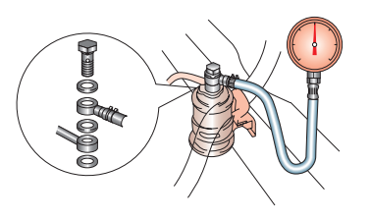
Troubleshooting
29.10 Conduct a pressure and volume output test on an electric fuel pump.
The fuel pressure test is the commonly used test for the fuel pump and related parts.
Before connecting this test, carefully inspect the system for leaks and repair them before continuing.
Then relieve the pressure in the system.
To conduct this test on specific fuel injection systems, refer to the service information for instructions.
Most domestic systems have a Schrader valve on the fuel rail, which can connect the fuel pressure gauge.
If the system does not have a Schrader valve, a tee should be installed in the fuel supply line.

Slide 27
Residual Pressure
29.11 Service and test electric fuel pumps.
Often, the cause of poor starting is the lack of residual pressure in the system.
This can be checked by looking at the pressure after the engine has been run and then turned off.
Using a pressure transducer and GMM or DSO allows you to monitor system pressure over a period of time without having to actually wait and watch a fuel pressure gauge.
The system should hold about the same pressure, for about 5 minutes, as it did during the pressure test.
If the pressure drops off quickly after the engine and ignition are turned off, there is a leakage problem in an injector, fuel pump, connectors, hoses, or pressure regulator.
To test if the pump is the cause of the dropping fuel pressure, pinch off the return hose with a pair of hose-pinching pliers.
Note that this can only be done on a section of rubber fuel hose.
Shut the engine off and immediately pinch off the return hose.

Slide 28
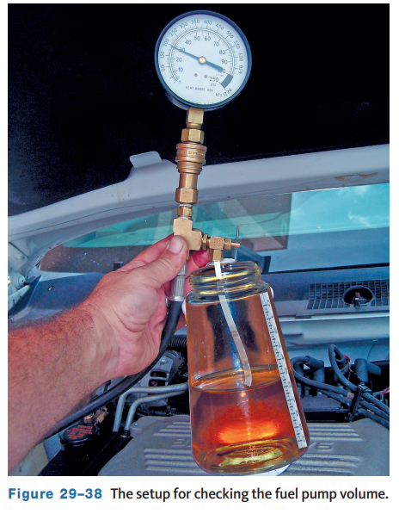
Fuel Volume Test
This test measures the flow rate of the pump and can help isolate fuel system restrictions or weak pumps.
The test is conducted by collecting the fuel dispensed during a period of time, which is normally 30 seconds.
Disconnect the return line on returnable systems or the supply line on returnless systems and connect a hose to end of the line.
Put the other end of the hose into a graduated container.
Turn on the fuel pump for about 30 seconds and measure the amount of fuel in the container.

Slide 29
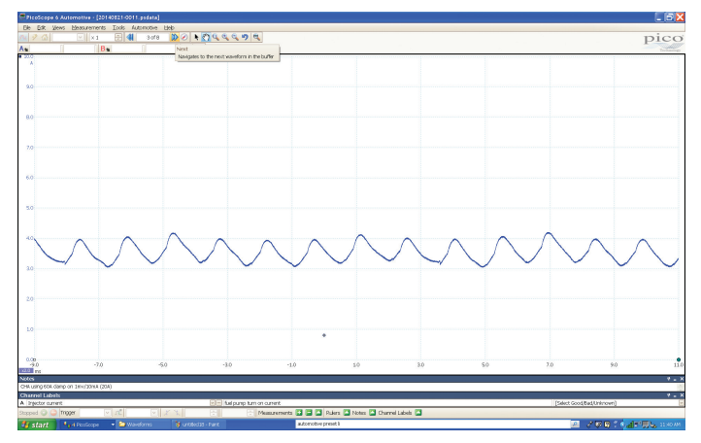
Using a Lab Scope
Monitoring the voltage and current to the fuel pump with a lab scope or GMM can give an idea of how well the pump is working.
The voltage traces show the voltage needed to establish current flow in the pump’s windings and should be consistent throughout the time period set on the scope.
The current pattern is made up of a series of small humps.
Each of the humps represents one commutator segment in the motor.
Each of the humps should look the same.

Slide 30
No-Start Diagnosis
When an engine fails to start because there is no fuel delivery, the first check is the fuel gauge.
A gauge that reads higher than a half tank probably means there is fuel in the tank, but not always.
A defective sending unit or faulty gauge might be giving a false indication.
Sticking a wire or dowel rod down the fuel tank filler pipe tells whether there really is fuel in the tank.
If the gauge is faulty, repair or replace it. Listen for pump noise.
When the key is turned on, the pump should hum for a couple of seconds to build system pressure.
On Ford vehicles, make sure the inertia switch has not been tripped. Hitting a large enough pothole can cause the inertia switch to open, shutting off the fuel pump.
The pump may be energized through an oil-pressure switch (the purpose of which is to shut off the flow of fuel in case of an accident that stalls the engine).

Slide 31
Replacement (1 of 2)
When replacing an electric pump, be sure that the new or rebuilt replacement unit meets the minimum requirements of pressure and volume for that particular vehicle.
This information can be found in the service information.
If the fuel pump is mounted in the fuel tank, the procedure for replacement is different than if the unit is external to the tank.

Slide 32
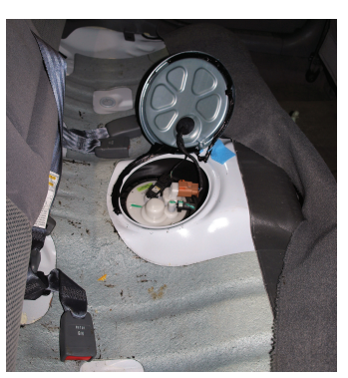
Replacement (2 of 2)
Internal Fuel Pump
  On many vehicles, the fuel tank must be removed to replace the fuel pump and/or fuel gauge sending unit.
  On other vehicles, the unit can be serviced through an opening under the rear seat or in the vehicle’s trunk.
  Some vehicles have a separate fuel pump and gauge sending unit, while others have both contained in a single unit. Once the fuel tank is empty and out of the vehicle, if necessary, remove the unit from the tank.
  These units are often held in the tank by either a retaining ring or screws.

Slide 33
GDI High-Pressure Pump (HPFP) Inspection and Replacement
General HPFP replacement steps are:
  Relieve system pressure before removing any fasteners or components.
  Remove any covers, the old pump, and high-pressure fuel supply line(s).
  Make sure the camshaft lobe is down or at its lowest position.
  Apply a light coat of oil to the O-ring that seals the pump to the engine, the roller tappet, and cam lobe.
  Set the new HPFP in place and start the mounting bolts by hand and then torque them to specification.
  Make sure the low-pressure supply line is fully attached to the pump. A new O-ring may be required.
  Install and tighten the high-pressure fuel line(s). Torque the fittings to spec.
  Start the engine and check for leaks. Ensure fuel pressure is correct.
  Reinstall any noise dampening covers that may have been removed.

Slide 34
Knowledge Check (2 of 2)
To replace the fuel pump on many vehicles, the fuel tank needs to be removed. What other methods may be used on some vehicles when replacing the fuel pump?

Slide 35
Knowledge Check Answer (2 of 2)
On other vehicles, the unit can be serviced through an opening under the rear seat or in the vehicle’s trunk.

Slide 36
Chapter Reflection
Please take a moment to compare your understanding of the fuel delivery system. Then respond to the following questions in one or two paragraphs. Use 150–200 words in your reflection.
Did parts of the fuel delivery system seem difficult to understand? How will you ensure you better your understanding of these systems?
Considering all you have learned, do you feel you are prepared to perform diagnosis and service on the fuel delivery system in the shop or lab setting? How can you become more prepared?

